Slide 1
Day 2
Regression Problem
Notes:
Regresyon nedir neden kurarız

Slide 2
What Will We Learn Today?
We will learn what is Regression problem in Machine Learning
We will learn about the kinds of models that can be developed to solve the regression problem.
We will learn the concept of error and its metrics in our regression model
We will learn to measure and improve performance in our regression model.
We will develop a Regression model using the iris dataset
Notes:
Konuşma diline yakın ver örneğin makine öğrenmesi modelinizdeki hatayı düşürmek daha iyi seviyeye getirmek gibi
Maddeli anlatma paragrafta anlat

Slide 3
Fethi Tekyaygil
Github: TekyaygilFethi
Twitter: fethidev
LinkedIn: fethitekyaygil

Slide 4

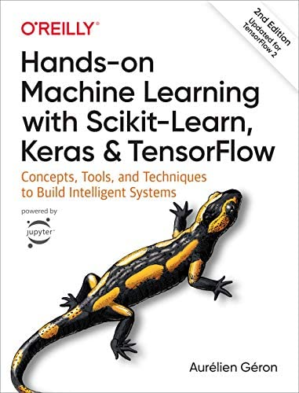
Sources
Deep Learning Türkiye
Hands-on Machine Learning with Scikit-Learn, Keras & TensorFlow
Aurelien Geron

Slide 5
What is Regression?
Regression determines the relationship between one dependent variable and one or more independent variables.
If the value predicted by the model is a continuous value, this type of problem is a Regression problem.
There are 3 different types of Regression according to the definition of the problem.
Notes:
daHA FAZLA BİLGİ İÇERSİN

Slide 6
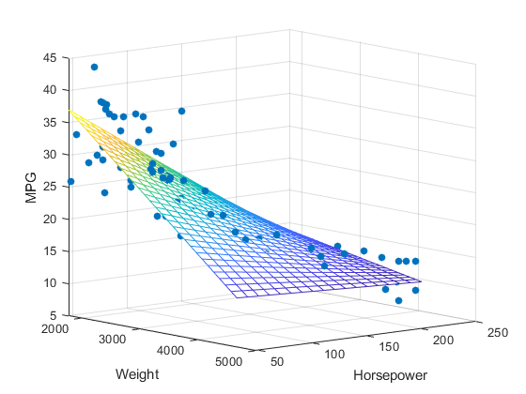
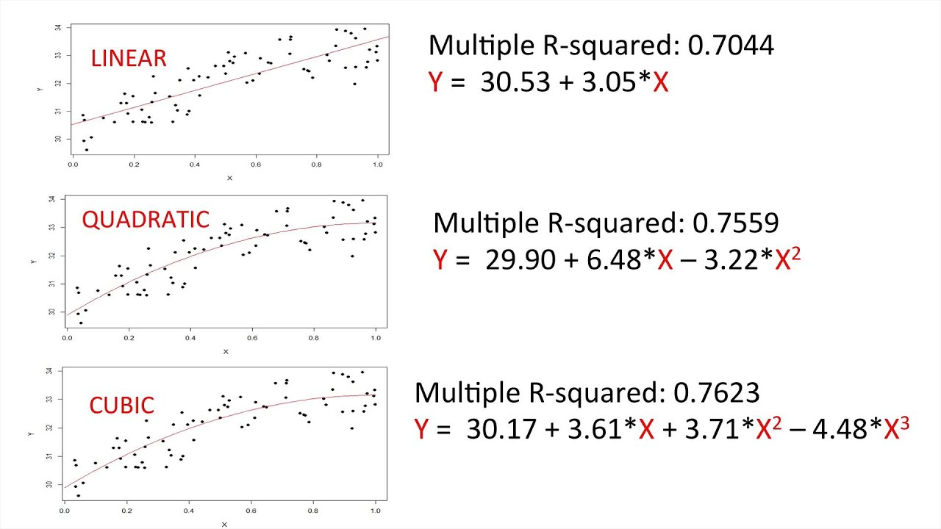
Regression Types
Simple Linear Regression: Regression type used when there is only one independent variable.
Multiple Linear Regression: It is a type of Regression used when there is more than one independent variable.
Polynomial Regression: It is a type of Regression in which the relationship between the independent variable x and the dependent variable y is modeled as an nth order polynomial in x.
Notes:
Boşluklar ekle göz yoruyor

Slide 7
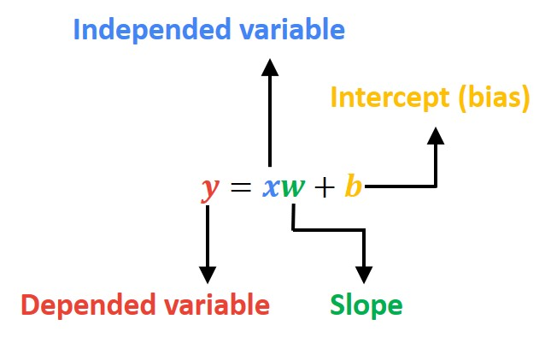

Basic Linear Regression
Simple Linear Regression uses an optimal straight line (also known as a regression line) to establish a relationship between a dependent variable (Y) and an independent variable (X).
Regression tries to find the most optimal line equation that will try to fit all points.
Notes:
Regresyon, tüm noktalara en yakın çizgiyi çizmeye çalışır

Slide 8
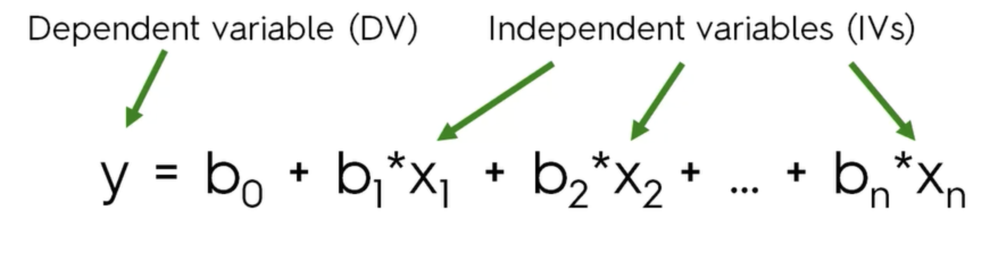
Multiple Linear Regression
Multiple Linear Regression uses an optimal straight line (also known as a regression line) to establish a relationship between the dependent variable (Y) and more than one independent variable (X).
Notes:
Bağımlı değişken label

Slide 9
Polynomial Regression
Polynomial Regression is a form of regression analysis in which the relationship between one or more independent variable x and dependent variable y is modeled as an nth order polynomial in x.
In cases where our simple and multiple linear regression models fail to predict (when our data is nonlinear), we can better fit our model to our data with the help of polynomial regression. For this, we need to give the features we give to the model in degrees (exponential).
Notes:
Neden kullanıyoruz

Slide 10
Measuring the Performance of the Regression Model

Slide 11
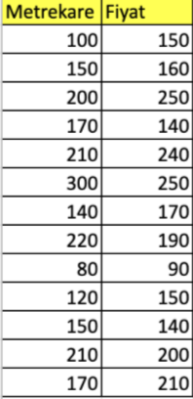
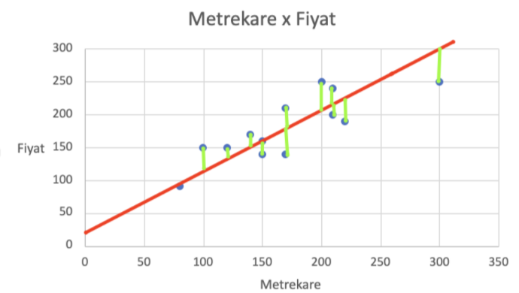
Error Concept
In our regression model, the error is the distance between the true value of the data and its predicted value. Our goal is to minimize this distance for each of our data points.
Since negative errors and positive errors cancel each other out, we use certain statistical equations to calculate the error instead of doing standard addition.

Slide 12
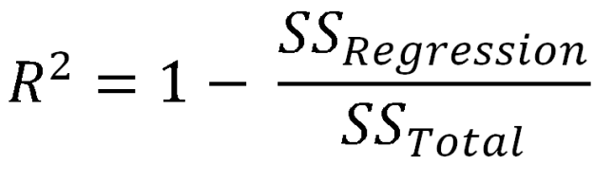
R-squared (R²)
R² is a statistical measure of how close the data are to the fitted regression line. That is, it is a measure of fitness for linear regression models.
✯ A high R² value does not always mean the model is good. In case of overfitting, our R² score will be high.
Notes:
.score yap modeli öncesinde fit et lineer regresyonda colabte

Slide 13
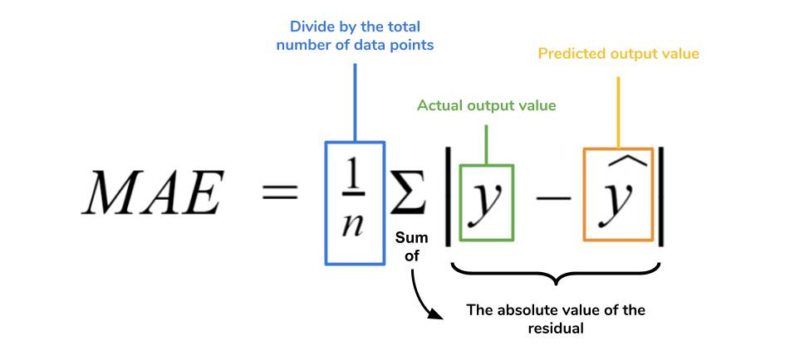
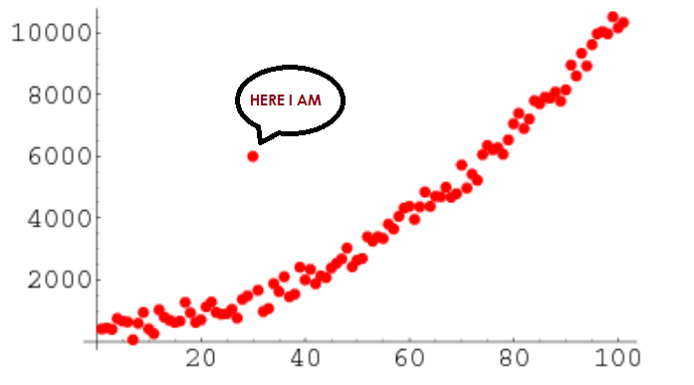
Mean Absolute Error (MAE)
The MAE is the mean of the absolute values of the differences between the predicted values and the actual values.The MAE method has the advantage of not being overly affected by outliers in the training data. A model trained with the MAE approach will give equal importance to 1 error of 5 units and 5 errors of 1 unit.
The main problem with MAE is that it is not at least differentiable. This lack of differentiability can produce convergence problems when training machine learning models.
Notes:
Güzel örnek bul türevlenebilirlik olması açısından

Slide 14
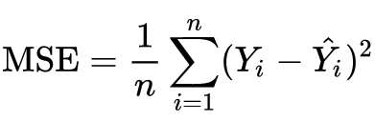
Mean Squared Error (MSE)
MSE is the most commonly used regression error function. Because of the squaring process, large errors (the difference between the actual value and the predicted value) have a greater impact on the MSE than small errors. It's really useful when you want to see if outliers are overly affecting your estimates.
The MSE function is widely used because it is simple, continuous, and differentiable.
An MSE-trained model will give the same importance to a single 5-unit error versus 25 1-unit errors. The model will be biased to reduce the largest errors

Slide 15
Mean Squared Error (MSE)
The mean square error function is widely used because it is simple, continuous, and differentiable.
An important MSE feature is its disproportionate sensitivity to large errors compared to small errors. An MSE-trained model will give the same importance to a single 5-unit error versus 25 1-unit errors. In other words, even if it penalizes the predictions of many common conditions, the model will be biased to reduce the largest errors.

Slide 16
Errors Encountered in Model Training
Underfitting & Overfitting
Notes:
Hepsi capitalize olarak yazılmasın -- DONE

Slide 17
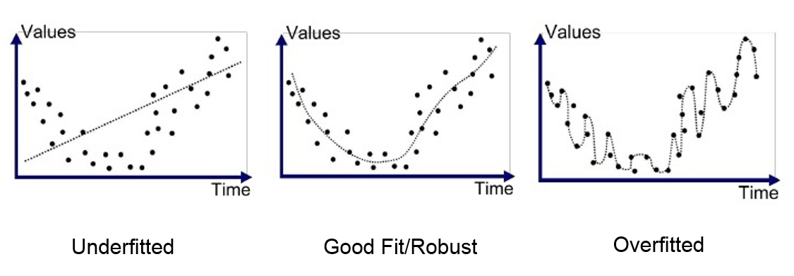
Underfitting & Overfitting
Underfitting
It is a problem that arises when the Machine Learning model fails to catch the trend of our data. In other words, our model does not learn enough from the data or does not extract enough meaning from the data.
Overfitting
It is a problem that arises when the Machine Learning model catches the trend of our data more than it should. In other words, our model memorizes the data we give it rather than learning it and cannot make a successful inference on data it has not seen before.

Slide 18
Underfitting & Overfitting
An important theoretical consequence of Statistics and Machine Learning is that the generalization (ability to make predictions using data it does not see) error of a model can be expressed as the sum of three very different errors:
Bias
Variance
Irreducible Errors
High bias means less variance, which is an example of underfit.
High variance means less bias, which is an example of overfit.
Irreducible errors are related to noise in the data and the only way to fix it is to clean the data
✯ An underfit model has low variance and high bias values.
✯ An overfit model has high variance and low bias.

Slide 19
Bias/Variance Tradeoff
Bias
Bias is the difference between the mean estimate of our model and the correct value we are trying to predict. The high-bias model pays little attention to the training data and oversimplifies the model. It always leads to high error in training and test data. This can be called underfit
Variance
Variance is the variability of the model estimate for a given data point. If a model with high complexity has high variance and thus overfits the training data, it causes errors in the predictions in the test set, which can be called overfit.
✯ As the bias increases, the variance decreases.
✯ As the variance increases, the bias decreases.
Notes:
Bullseye resmi ekle

Slide 20
What can be done?
Underfitting
1. The complexity of the model can be increased by adding new feature values or layers
2. Noise can be removed from data
3. The number of epochs can be increased during training
4. Better feature values can be given (Feature Engineering)
5. Values that limit the model can be reduced (eg regularization parameter)
Overfitting
1. Training data can be increased
2. The complexity of the model can be reduced
3. Early stopping can be done during training
4. Regularization can be applied
Notes:
CNN den örnek ver katman ekledikçe daha karmaşık şeyleri öğrenebiliyor

Slide 21
Error Reduction Methods

Slide 22
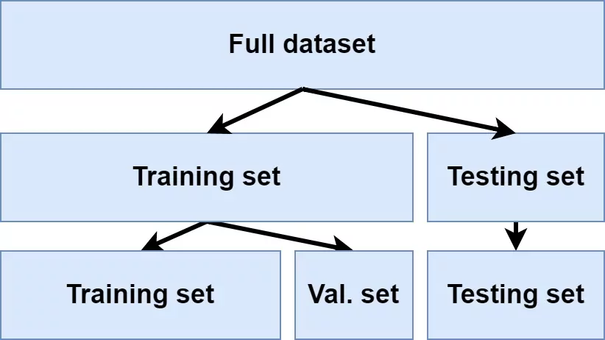
Splitting of Data as Training-Test-Validation
Our data is sent to the model for training. Our model learns from the data and improves itself by going over the learned data over and over again. (forward-backward prop.)
After the training is completely finished, the model measures itself with the data used in the learning in order to score itself.
If the score is high, our model is successful.
When data is sent to the model that is not among the dataset given for training, it can be seen that the model does not actually make as successful predictions as it claims.

Slide 23
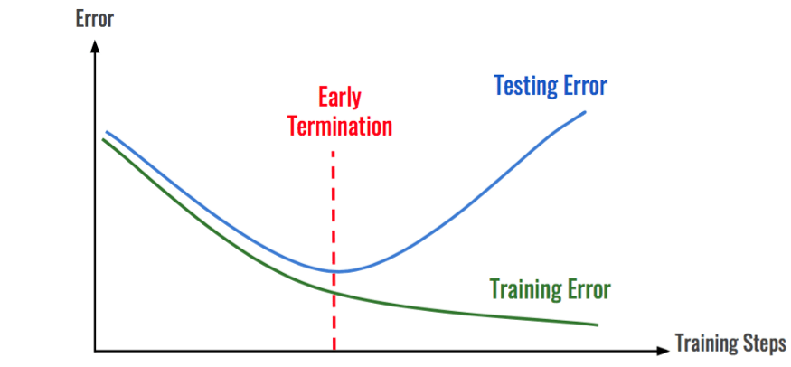
Early Stopping
The way to streamline iterative learning algorithms like Gradient Descent is to stop training as soon as the validation error reaches a minimum.
A simple and effective editing technique called the "No Free Lunch Theorem" by Geoffrey Hinton, winner of the 2018 Turing Award with Yoshua Bengio and Yann LeCun
A minimum error value is determined and n more iterations occur when the validation set error falls below or equals this limit. If our performance does not improve, our error value returns to the best point and training stops.(callback)

Slide 24
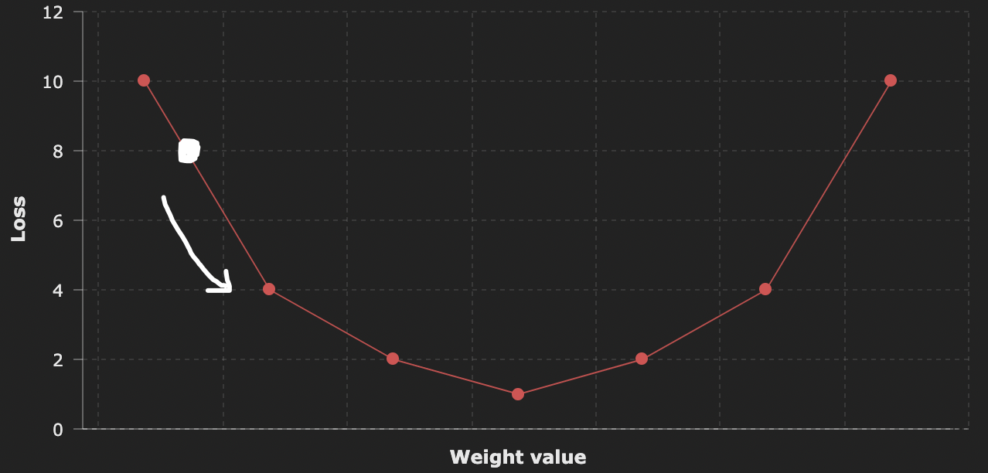
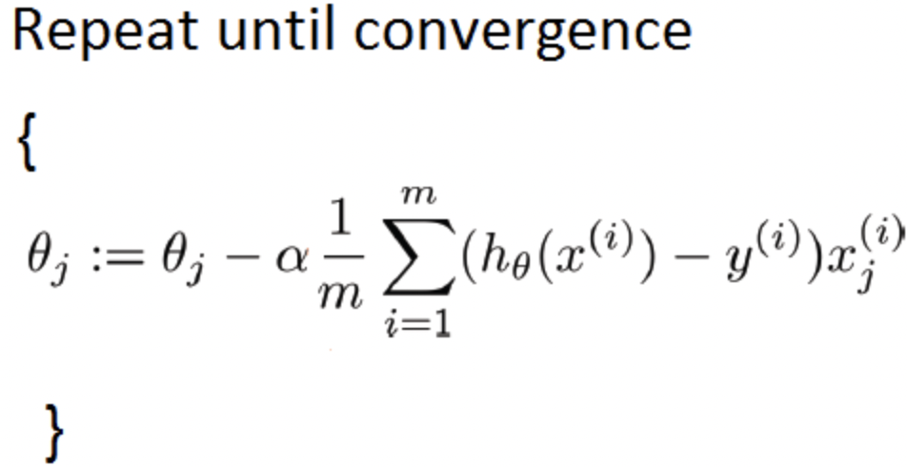
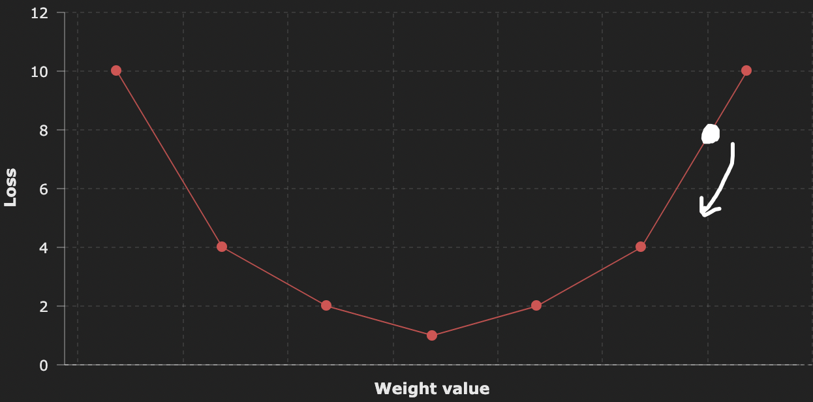
Gradient Descent
The general idea of Gradient Descent is to iteratively adjust the weights to minimize a output of cost function. It does this until the error value converges to the local minimum.
Gradient Descent does exactly this: It measures the local gradient of the error function relative to the parameter vector θ and goes in the decreasing gradient direction. When the gradient is zero, the optimum weight value is found.

Slide 25
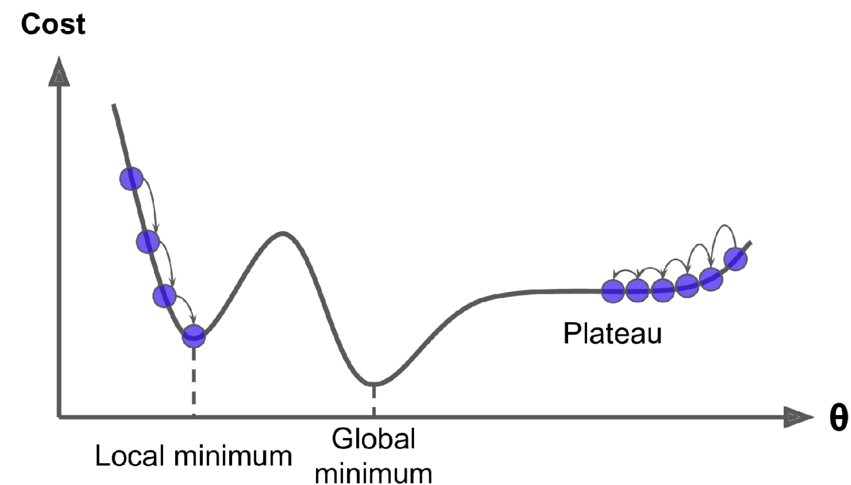
Gradient Descent
Not all cost functions are convex, which causes the algorithm to converge to the local minimum.
Cost functions such as MSE and MAE are in the form of convex. This way we can be sure that there is only one global minimum.
✯ When using Gradient Descent, you should make sure that all features have a similar scale. (e.g. using Scikit-Learn's StandardScaler class) or it will take much longer to converge

Slide 26
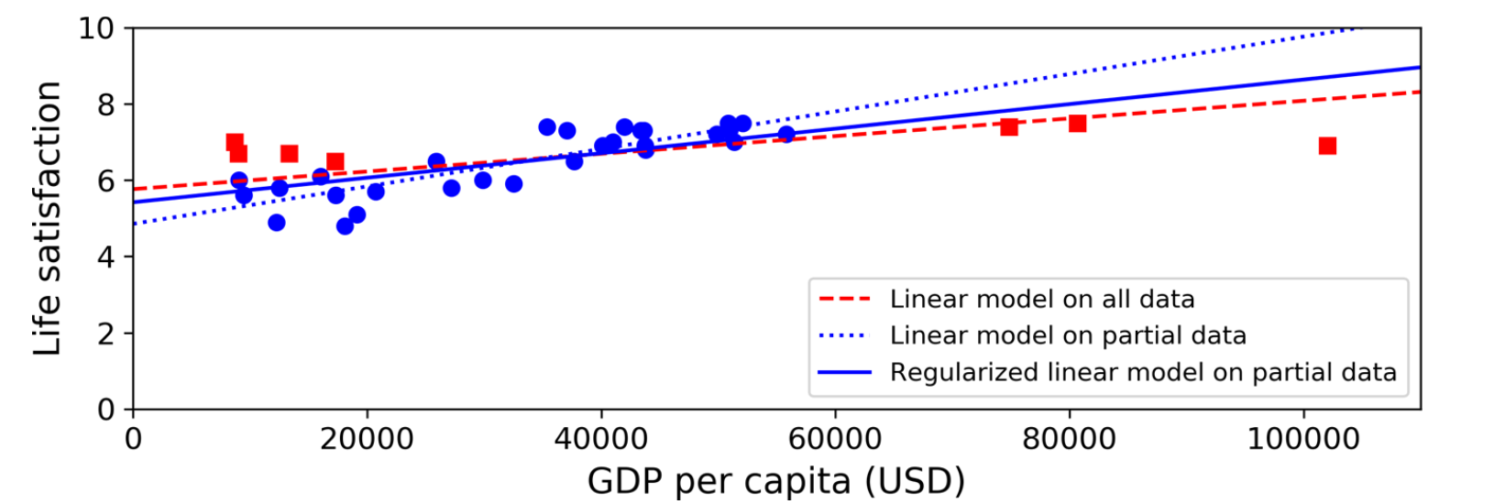
Regularization
Regularization is the process of constraining a model to simplify and prevent overfitting. This improves the model's performance on invisible data. In this method, the weights in the cost function are updated by adding another term known as the regularization term, that is, they are penalized..
✯ The amount of regularization to be applied during learning can be controlled by a hyper parameter called regularization term (regularization parameter).

Slide 27
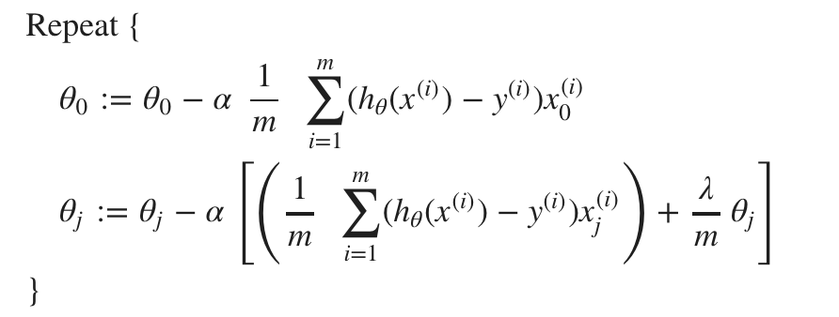

Regularization
L1 Lasso
In L1 regularization the error function is penalized by the absolute value of the weights
The derivative of L1 is k (a constant whose value is independent of weight)
It is a force that subtracts the derivative of L1 from the weight some constant each time.
L2 Ridge
In L2 regularization, the error function is penalized by the square of the weights.
The derivative of L2 is 2 * weight
It is a force that removes x% of the weight each time the derivative of L2

Slide 28
Regularization
L1 Lasso
L1 can solve the multicollinearity problem by limiting the coefficient norm and fixing some coefficient values to 0. Multicollinearity is when two independent variables are highly correlated.
If you have more features than the number of observations (N), L1 holds at most N coefficients.
L1 is sometimes used as a feature selection method. If you have some kind of hard limit on the number of features you can use, you can try using L1 regularization to get any number of non-zero features.
L2 Ridge
L2 can solve the multicollinearity problem by limiting the coefficient norm and keeping all variables
The "classic" method of solving the regression problem where you have more features than the number of observations (N)
L2 can estimate a coefficient for each feature even if there are more features than observations

Slide 29
Hyper Parameter Definitions
Learning Rate (𝞪): It determines the rate at which the error converges to the optimum point during operation of the Gradient Descent.
Theta (ϴ): It is the weight of our feature value.
Regularization Term (𝛌): It is the penalty term or regulation parameter that determines how much weight will be penalized. If too much is given, our weights will be close to 0. This prevents our model from being overfit, but at the same time, the model it creates will not be very efficient.

Slide 30
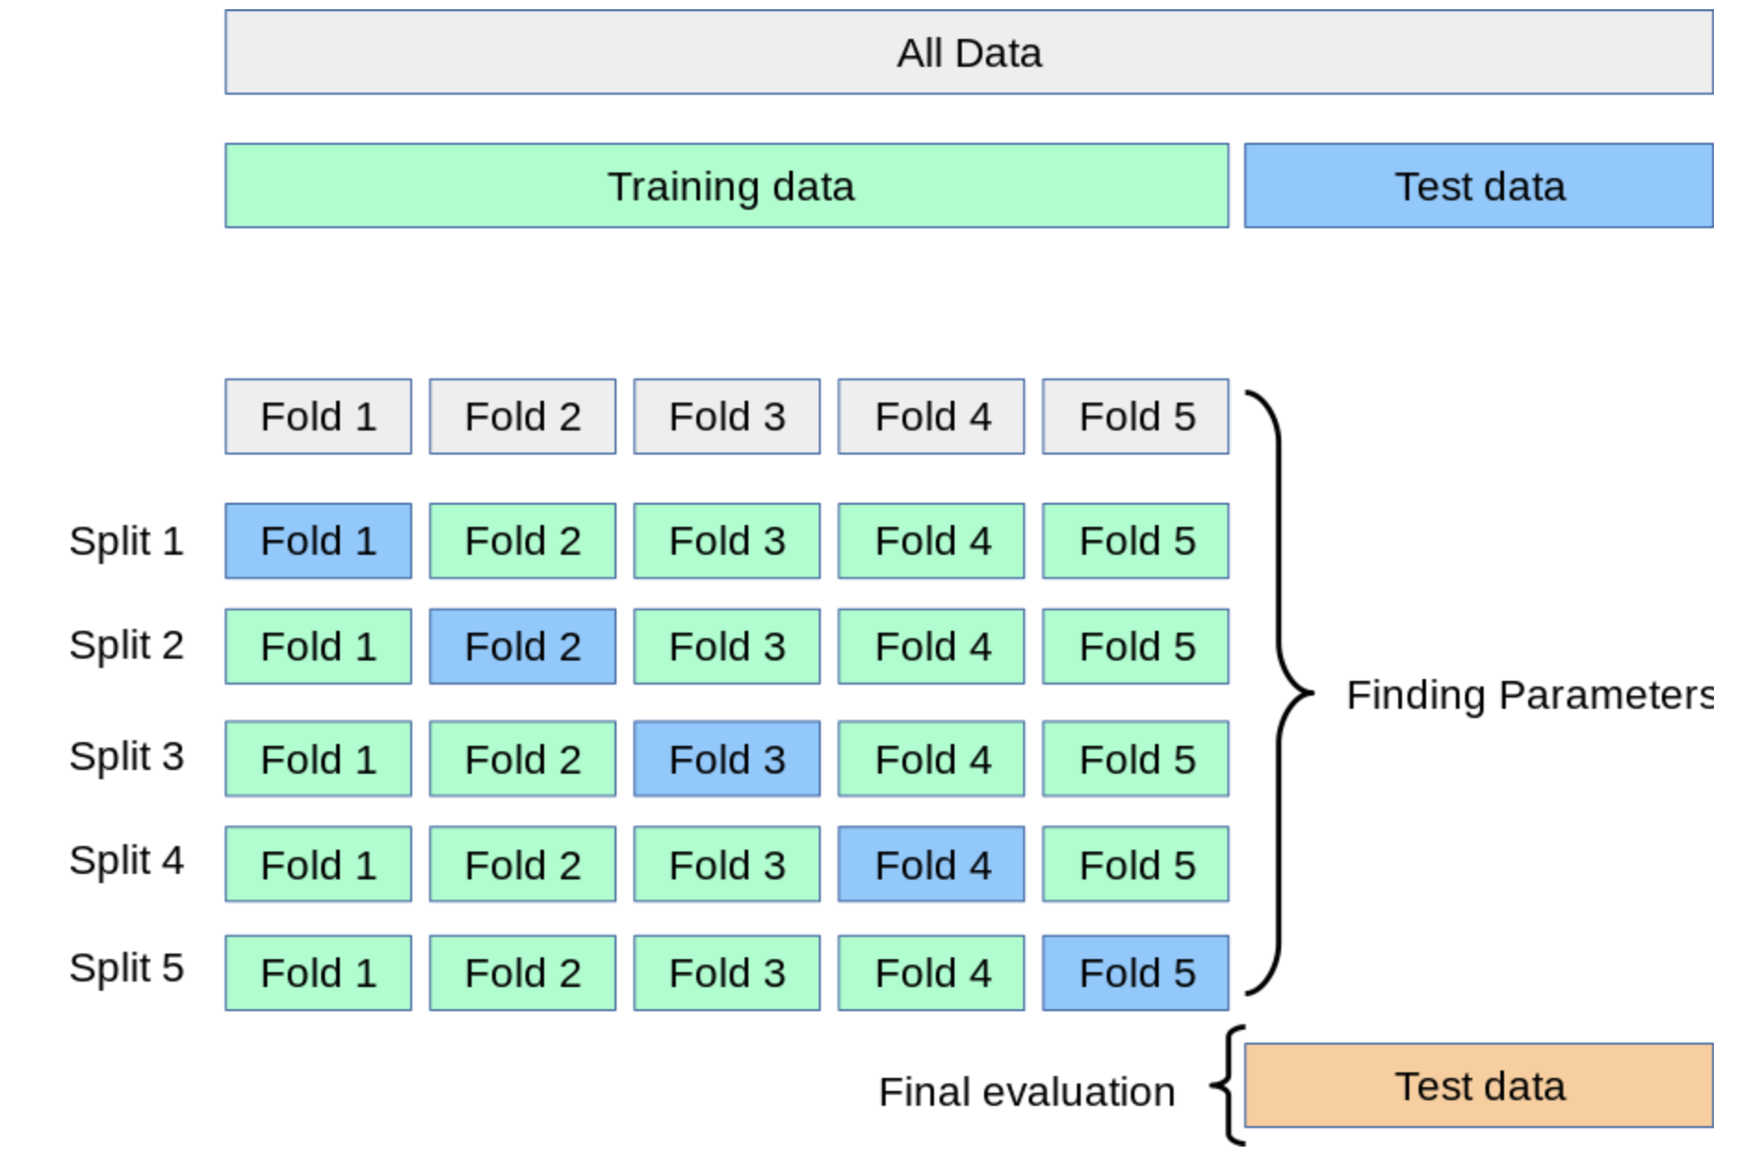
Cross Validation
Cross-validation is a statistical resampling method used to improve the performance of a machine learning model. This is done to prevent the model from focusing too much on the initial dataset.
By dividing our data set into k parts, training is carried out with each part and the performance of our model is measured by taking the average of these errors.

Slide 31
Colab Time!

